Slide 1

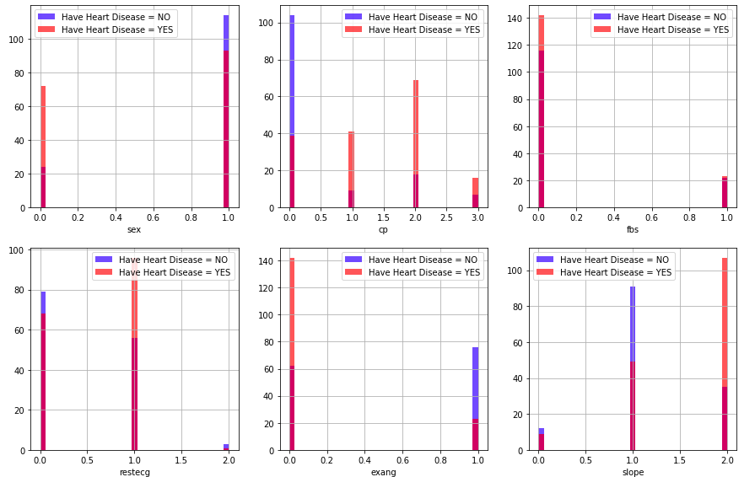
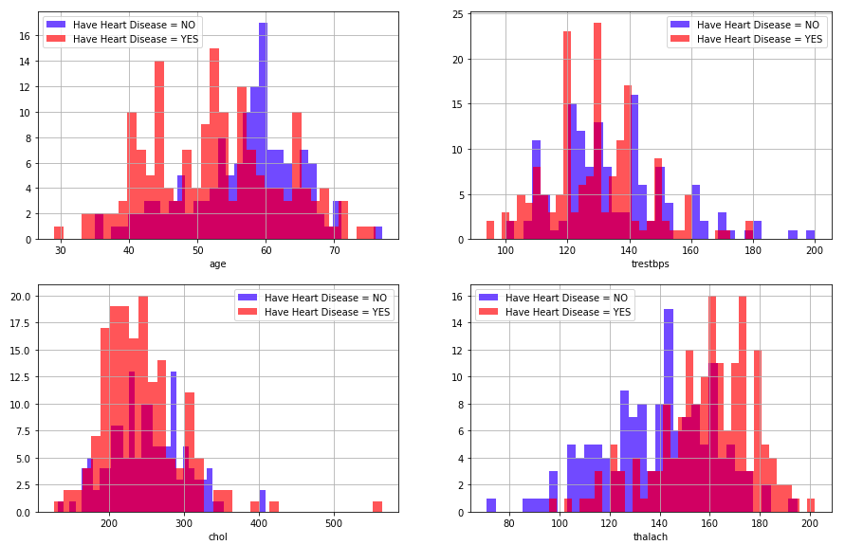
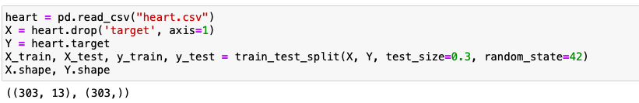
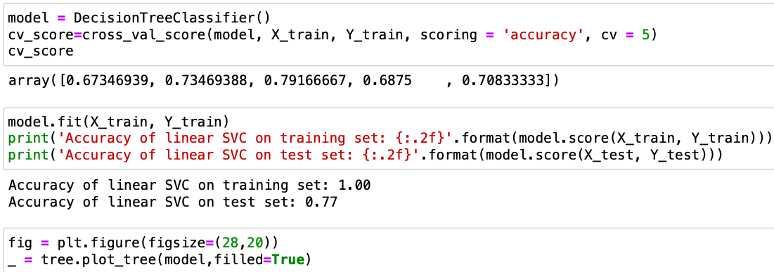
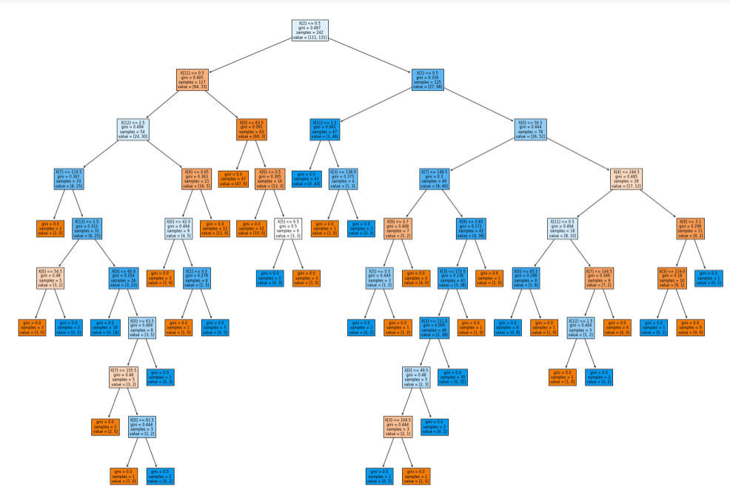

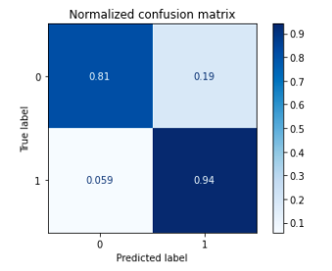
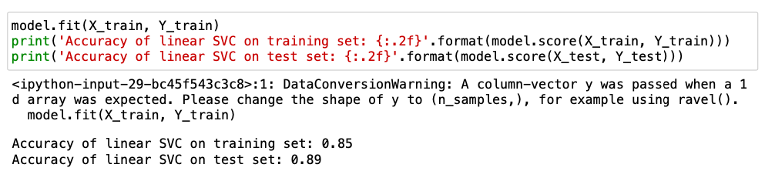
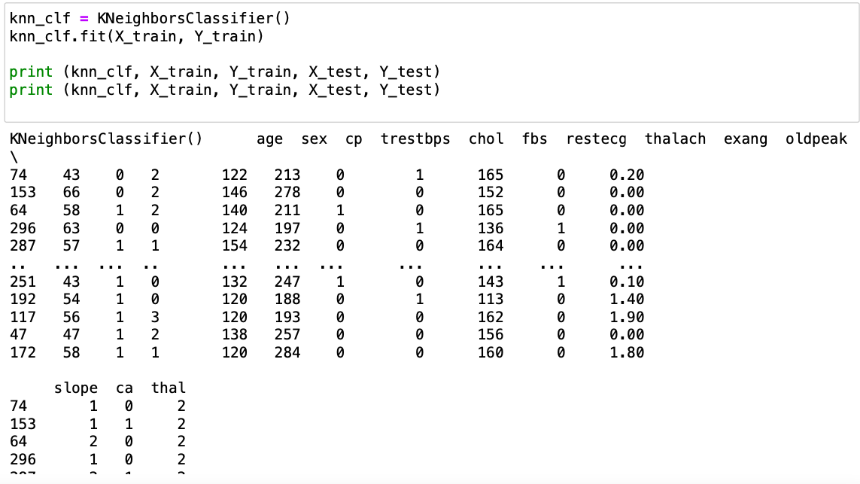
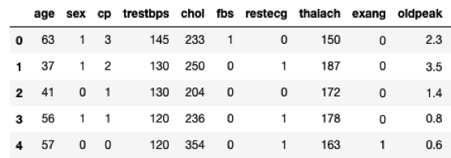
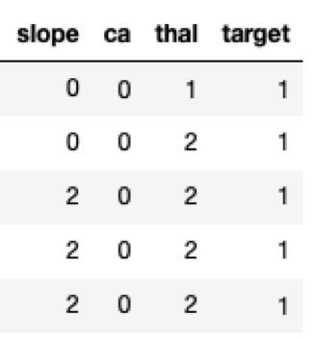
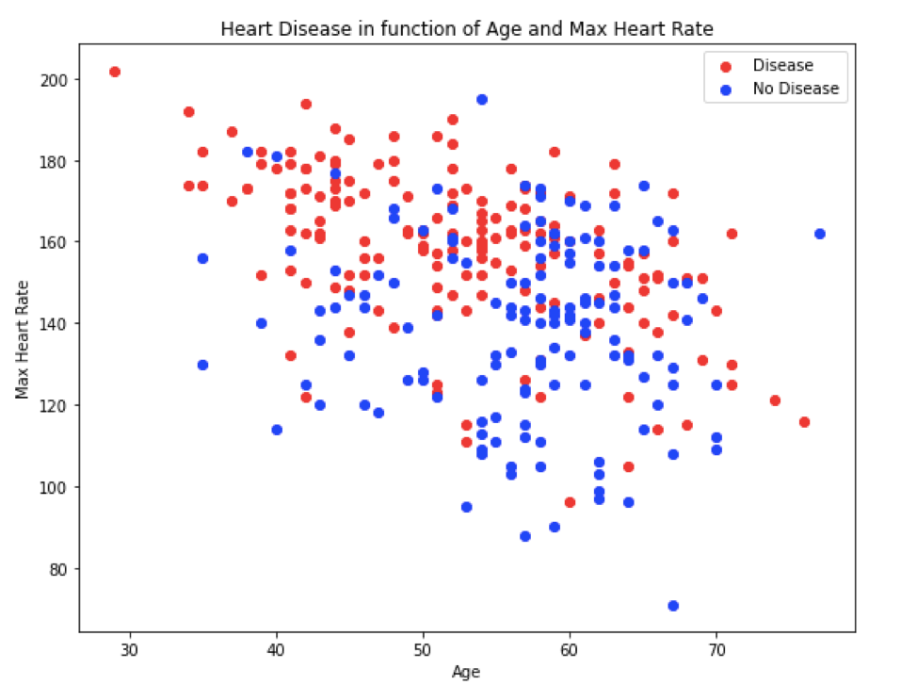
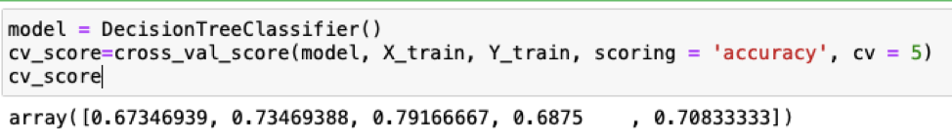
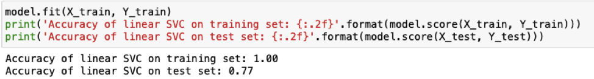
Computer Science Department
Final Project: Project title
Course: Introduction to AI (CS156s4)
Course Instructor: Yulia Newton, Ph.D.
Student Name: Hanh Nguyen
Introduction/Background
Methodology
Analysis and Results
cp (Chest Pain): The test shows that people who have cp equal to 1, 2, 3 possibly have more heart disease than others with cp equal to 0.
Prediction problem: “Predicting heart disease using machine learning.” It is an interesting project because by using parameters in clinical on a patient, we can predict whether they can have heart disease or not have heart disease. One of the most dangerous diseases is cardiovascular disease. Heart disease is taking the lives of many people all over the world. There are many causes related to cardiovascular diseases, such as diabetes and hypertension. These diseases need early detection to prevent heart diseases. Therefore, model machine learning to predict heart diseases will help in this situation. There have been other previous solutions, such as using “strength scores with significant predictors.” Although there are many predictable solutions for heart diseases, the final result is diagnosing and predicting heart diseases based on current clinical tests of patients. So I agree with the approach I referenced on the link: https://www.kaggle.com/faressayah/predicting-heart-disease-using-machine-learning/notebook. There are a few things I will do differently. I will use a pair plot in the seaborn library to plot statistics, a decision tree classifier to use sub-features in different classification stages, and normalization databases. The purpose of normalization is to store logical data and remove useless data.
Algorithm
Decision Tree Classifier: It can be used for both classification and regression supervised problems. The hierarchical tree which can be traversed to make a decision.
Random Forest Classifier: I use Random Forest because it is considered to have high accuracy in terms of the number of decision trees involved in the process. It can also handle missing values.
K-nearest neighbors Classifier: KNN is easy to implement in the most basic form. However, it performs more complex classification tasks.
Explore Heart Disease
Validation/cross-validation results
The result shows that trestbps: resting blood pressure (mm Hg) above 130-140 is a typical cause for concern. Chol: serum cholesterol (mg/dl) above 200 is cause for concern. thalach (maximum heart rate achieved): more than 140 are causes for heart disease.
Decision trees are computationally faster
Random Forest Classifier
K-nearest neighbors Classifier:
Training results
The confusion matrix with normalization by class support size (elements’ number in each class); In this case, if a class is out of balance, it will more visually explain which one is being misclassified.
Summary/Conclusions
I have successfully loaded the data to get the cardiovascular disease information to make sure there are no null values. I use loc for selecting data in Pandas to display the desired result separately. Using the function subplot to create layouts, they can show us the patients have heart diseases or do not have heart diseases. Besides, the graphs also show heart disease of Age and max heart rate. It is helpful information.
If I have more time than now, I would like to do more modeling in machine learning, such as logistic regression, Support Vector machines.
Dataset description
I am going to use “Heart Disease UCI” datasets from the URL: https://www.kaggle.com/ronitf/heart-disease-uci. I am done with downloading the Heart.csv dataset. The independent variable: age, sex, chest pain type(cp), resting blood pressure(trestbps), serum cholesterol(chol), fasting blood sugar(fbs), resting electrocardiographic(restecg), maximum heart rate achieved (thalach), exercise-induced angina(exang), ST depression induced by exercise relative to rest(oldpeak). The columns of the dataset represent all the information about the patient, such as age, sex, and parameter in clinical. The variables are numeric.
Four dependent variables on the right are the output of the process. They are also numeric variables.
For example: using a cross-validation approach
Accuracy of linear SVC on training set
Test results
This is the relationship between heart disease and age. Maximum heart rate varies depending on age. People with a high heart rate have a higher risk of heart disease.
Heart Disease of Age and Max Heart Rate
Key References
[1] Faressayah. (2021, August 24). Predicting heart disease using machine learning 🩺. Kaggle: Your Machine Learning and Data Science Community. https://www.kaggle.com/faressayah/predicting-heart-disease-using-machine-learning/notebook
[2] Heart disease UCI. (n.d.). Kaggle: Your Machine Learning and Data Science Community. https://www.kaggle.com/ronitf/heart-disease-uci
Application to the project
The goal is to create a model that predicts values ​​using simple rules. “Normalization refers to rescaling real-valued numeric attributes into a 0 to 1 range.” Normalization makes model training less sensitive to the features’ scale. It leads to a more accurate model.
Acknowledgements
I think endorsements from instructors, classmates, and colleagues are most appropriate.

